Slide 1

Learning Objectives:
I can explain what malware is and the different types of malware (e.g., viruses, ransomware, spyware).
I can understand the consequences of a malware infection on personal and organisational systems.
I can identify methods to prevent and respond to malware attacks in real-time.
Success Criteria:
All: Identify different types of malware and explain their basic function.
Most: Recognise malware activity and simulate a response plan for containing the attack.
Some: Analyse the effectiveness of different malware prevention strategies and develop a rapid response protocol.

Slide 2
Malware Alert! The School Network is Under Attack!
Scenario: The school network has been infected by malware! Your job is to stop the attack before it spreads and affects critical data.
Types of Malware Involved:
Viruses: Spread through infected files, damaging systems.
Ransomware: Locks access to files, demands payment.
Spyware: Secretly gathers personal or sensitive data.
Definition of Malware: Malicious software designed to cause harm or steal information. It disrupts systems or encrypts data to make it inaccessible.

Slide 3
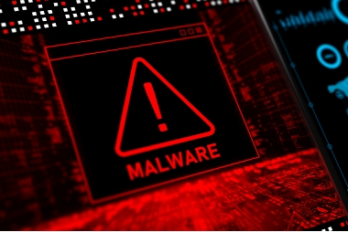
"Warning! Ransomware Detected!"
"Your Files Are Encrypted! Pay $500 in Bitcoin to Recover Your Files!"
In pairs, students will use Clue Sheets to identify the malware infecting the system based on the symptoms described.

Slide 4
Malware Outbreak Simulation – Clue Sheet
Clue 1: "Several computers are suddenly running very slowly, and some files on the system appear to be locked or inaccessible."
Clue 2: "A pop-up message has appeared on the screen: 'Your files are encrypted! Pay $500 in Bitcoin to get them back! You have 72 hours.'"
Clue 3: "There is a noticeable increase in network traffic originating from an unknown IP address: 192.168.1.103."
Clue 4: "A teacher’s sensitive files (containing personal student data) have been accessed without permission and are now missing."
Clue 5: "Antivirus software on some of the computers is disabled, and users cannot run a scan or install updates."
Clue 6: "Emails are being sent from school email accounts without the owners' knowledge."

Slide 5
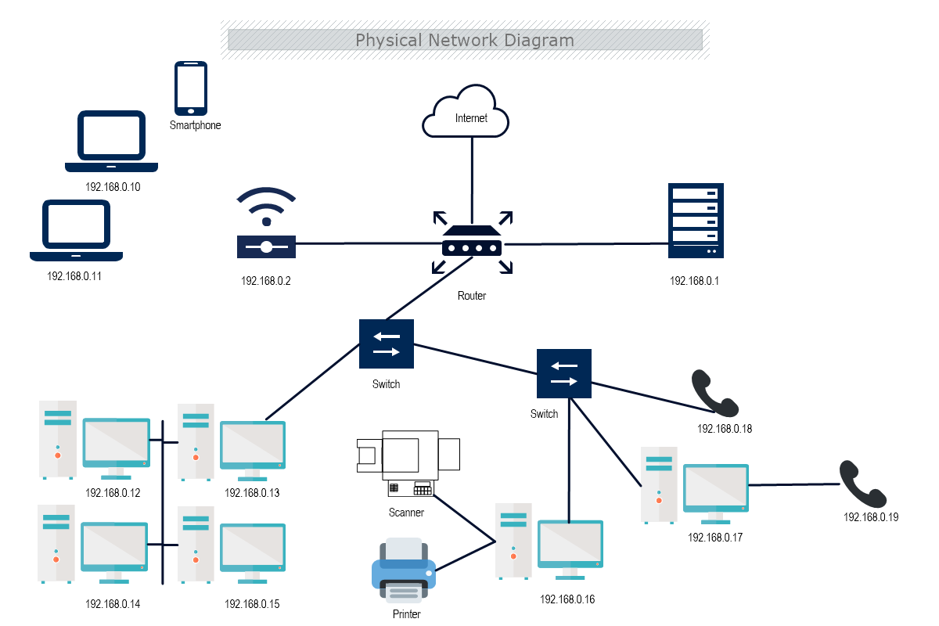
Contain the Attack
Step 1: Isolate Infected Systems
Disconnect infected devices from the network.
Block suspicious IP addresses.

Slide 6
Identify the Malware
Identify the Malware
Content:
Analyse the clues: What type of malware is affecting the system?
Discuss with your team: Is it a virus, ransomware, or spyware?
Virus: Infects files, spreads rapidly.
Ransomware: Locks files, demands payment.
Spyware: Steals information silently.
Highlight the clues in their printed handouts that match each malware type.

Slide 7

Restore the Systems
Use backup systems to restore files.
Identify and eliminate the malware source.
Teacher Prompt: “What steps did you take to stop the attack?”

Slide 8
Plenary – Malware Impact Reflection
How did you identify the malware?
What was the most challenging part of containing the malware?
How would you improve your response strategy?

Slide 9
Self-Assessment
All: Identify different types of malware and explain their basic function.
Most: Recognise malware activity and simulate a response plan for containing the attack.
Some: Analyse the effectiveness of different malware prevention strategies and develop a rapid response protocol.

